Slide 1
Differentiation

Slide 2
Calculus
Calculus is the study of how things change and in particular the rate, or speed, at which they change. It enables us to mathematically model many and various different situations which then enables us to understand what is happening as things change and to predict behaviour.

Slide 3
Calculus
There are two branches of calculus: differential calculus (or differentiation) and integral calculus (or integration).
There are many applications of differential calculus in engineering and science including modelling velocities and accelerations, flow rates and finding maximum and minimum values.

Slide 4
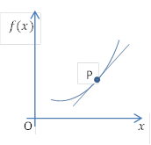
Finding the gradient of a curve

Slide 5
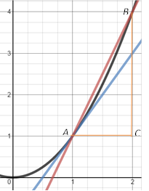
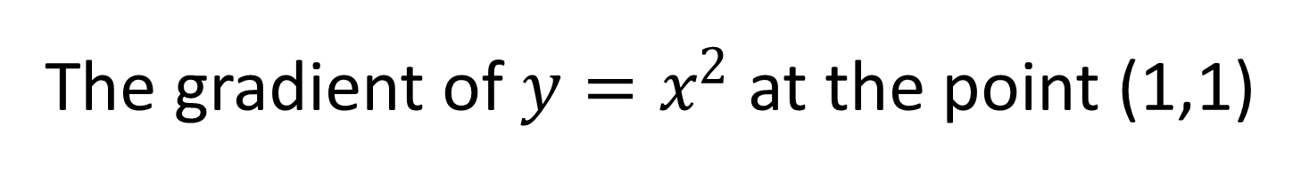
The gradient of $y=x^{2}$ at the point (1,1)
Co-ordinates of B | BC | AC | Gradient BC/AC
(2,4) | 3 | 1 | 3
(1.5,2.25) | 1.25 | 0.5 | 2.5
(1.1, 1.21) | 0.21 | 0.1 | 2.1
(1.01, 1.0201) | 0.0201 | 0.01 | 2.01

Slide 6
The gradient of $y=x^{2}$ at the point (1,1)
Co-ordinates of B | BC | AC | Gradient BC/AC
(2,4) | 3 | 1 | 3
(1.5,2.25) | 1.25 | 0.5 | 2.5
(1.1, 1.21) | 0.21 | 0.1 | 2.1
(1.01, 1.0201) | 0.0201 | 0.01 | 2.01

Slide 7
The gradient of $y=x^{2}$ at the point (1,1)
Co-ordinates of B | BC | AC | Gradient BC/AC
(2,4) | 3 | 1 | 3
(1.5,2.25) | 1.25 | 0.5 | 2.5
(1.1, 1.21) | 0.21 | 0.1 | 2.1
(1.01, 1.0201) | 0.0201 | 0.01 | 2.01

Slide 8
The gradient of $y=x^{2}$ at the point (1,1)
Co-ordinates of B | BC | AC | Gradient BC/AC
(2,4) | 3 | 1 | 3
(1.5,2.25) | 1.25 | 0.5 | 2.5
(1.1, 1.21) | 0.21 | 0.1 | 2.1
(1.01, 1.0201) | 0.0201 | 0.01 | 2.01

Slide 9
The gradient of $y=x^{2}$ at the point (1,1)
Co-ordinates of B | BC | AC | Gradient BC/AC
(2,4) | 3 | 1 | 3
(1.5,2.25) | 1.25 | 0.5 | 2.5
(1.1, 1.21) | 0.21 | 0.1 | 2.1
(1.01, 1.0201) | 0.0201 | 0.01 | 2.01

Slide 10
The gradient of $y=x^{2}$ at the point (1,1)
Co-ordinates of B | BC | AC | Gradient BC/AC
(2,4) | 3 | 1 | 3
(1.5,2.25) | 1.25 | 0.5 | 2.5
(1.1, 1.21) | 0.21 | 0.1 | 2.1
(1.01, 1.0201) | 0.0201 | 0.01 | 2.01

Slide 11
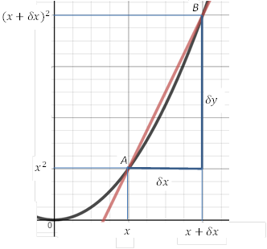
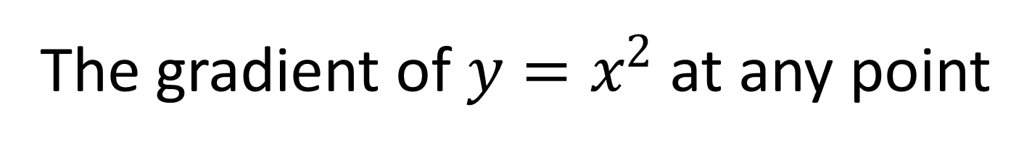


The gradient of $y=x^{2}$ at any point
The gradient of chord AB =
$$\frac{δy}{δx}=\frac{{(x+δx)}^{2}−x^{2}}{δx} \\ =\frac{x^{2}+2xδx+{(δx)}^{2}−x^{2}}{δx} \\ =\frac{2xδx+{(δx)}^{2}}{δx} \\ =2x+δx$$
Now as B moves along the line towards A, $δx→0$ and $\frac{δy}{δx}→2x$
So the gradient of the curve at A, $\frac{dy}{dx}$ is given by
$$\frac{dy}{dx}=\lim_{δx→0}{\frac{δy}{δx}=2x}$$

Slide 12
The gradient of $y=x^{2}$ at any point
The gradient of chord AB =
$$\frac{δy}{δx}=\frac{{(x+δx)}^{2}−x^{2}}{δx} \\ =\frac{x^{2}+2xδx+{(δx)}^{2}−x^{2}}{δx} \\ =\frac{2xδx+{(δx)}^{2}}{δx} \\ =2x+δx$$
Now as B moves along the line towards A, $δx→0$ and $\frac{δy}{δx}→2x$
So the gradient of the curve at A, $\frac{dy}{dx}$ is given by
$$\frac{dy}{dx}=\lim_{δx→0}{\frac{δy}{δx}=2x}$$

Slide 13
The gradient of $y=x^{2}$ at any point
The gradient of chord AB =
$$\frac{δy}{δx}=\frac{{(x+δx)}^{2}−x^{2}}{δx} \\ =\frac{x^{2}+2xδx+{(δx)}^{2}−x^{2}}{δx} \\ =\frac{2xδx+{(δx)}^{2}}{δx} \\ =2x+δx$$
Now as B moves along the line towards A, $δx→0$ and $\frac{δy}{δx}→2x$
So the gradient of the curve at A, $\frac{dy}{dx}$ is given by
$$\frac{dy}{dx}=\lim_{δx→0}{\frac{δy}{δx}=2x}$$

Slide 14
The gradient of $y=x^{2}$ at any point
The gradient of chord AB =
$$\frac{δy}{δx}=\frac{{(x+δx)}^{2}−x^{2}}{δx} \\ =\frac{x^{2}+2xδx+{(δx)}^{2}−x^{2}}{δx} \\ =\frac{2xδx+{(δx)}^{2}}{δx} \\ =2x+δx$$
Now as B moves along the line towards A, $δx→0$ and $\frac{δy}{δx}→2x$
So the gradient of the curve at A, $\frac{dy}{dx}$ is given by
$$\frac{dy}{dx}=\lim_{δx→0}{\frac{δy}{δx}=2x}$$

Slide 15
The gradient of $y=x^{2}$ at any point
The gradient of chord AB =
$$\frac{δy}{δx}=\frac{{(x+δx)}^{2}−x^{2}}{δx} \\ =\frac{x^{2}+2xδx+{(δx)}^{2}−x^{2}}{δx} \\ =\frac{2xδx+{(δx)}^{2}}{δx} \\ =2x+δx$$
Now as B moves along the line towards A, $δx→0$ and $\frac{δy}{δx}→2x$
So the gradient of the curve at A, $\frac{dy}{dx}$ is given by
$$\frac{dy}{dx}=\lim_{δx→0}{\frac{δy}{δx}=2x}$$

Slide 16
The gradient of $y=x^{2}$ at any point
The gradient of chord AB =
$$\frac{δy}{δx}=\frac{{(x+δx)}^{2}−x^{2}}{δx} \\ =\frac{x^{2}+2xδx+{(δx)}^{2}−x^{2}}{δx} \\ =\frac{2xδx+{(δx)}^{2}}{δx} \\ =2x+δx$$
Now as B moves along the line towards A, $δx→0$ and $\frac{δy}{δx}→2x$
So the gradient of the curve at A, $\frac{dy}{dx}$ is given by
$$\frac{dy}{dx}=\lim_{δx→0}{\frac{δy}{δx}=2x}$$

Slide 17
The gradient of $y=x^{2}$ at any point
The gradient of chord AB =
$$\frac{δy}{δx}=\frac{{(x+δx)}^{2}−x^{2}}{δx} \\ =\frac{x^{2}+2xδx+{(δx)}^{2}−x^{2}}{δx} \\ =\frac{2xδx+{(δx)}^{2}}{δx} \\ =2x+δx$$
Now as B moves along the line towards A, $δx→0$ and $\frac{δy}{δx}→2x$
So the gradient of the curve at A, $\frac{dy}{dx}$ is given by
$$\frac{dy}{dx}=\lim_{δx→0}{\frac{δy}{δx}=2x}$$

Slide 18
The gradient of $y=x^{2}$ at any point
The gradient of chord AB =
$$\frac{δy}{δx}=\frac{{(x+δx)}^{2}−x^{2}}{δx} \\ =\frac{x^{2}+2xδx+{(δx)}^{2}−x^{2}}{δx} \\ =\frac{2xδx+{(δx)}^{2}}{δx} \\ =2x+δx$$
Now as B moves along the line towards A, $δx→0$ and $\frac{δy}{δx}→2x$
So the gradient of the curve at A, $\frac{dy}{dx}$ is given by
$$\frac{dy}{dx}=\lim_{δx→0}{\frac{δy}{δx}=2x}$$

Slide 19
The gradient of $y=x^{2}$ at any point
The gradient of chord AB =
$$\frac{δy}{δx}=\frac{{(x+δx)}^{2}−x^{2}}{δx} \\ =\frac{x^{2}+2xδx+{(δx)}^{2}−x^{2}}{δx} \\ =\frac{2xδx+{(δx)}^{2}}{δx} \\ =2x+δx$$
Now as B moves along the line towards A, $δx→0$ and $\frac{δy}{δx}→2x$
So the gradient of the curve at A, $\frac{dy}{dx}$ is given by
$$\frac{dy}{dx}=\lim_{δx→0}{\frac{δy}{δx}=2x}$$

Slide 20
The gradient of $y=x^{2}$ at any point
The gradient of chord AB =
$$\frac{δy}{δx}=\frac{{(x+δx)}^{2}−x^{2}}{δx} \\ =\frac{x^{2}+2xδx+{(δx)}^{2}−x^{2}}{δx} \\ =\frac{2xδx+{(δx)}^{2}}{δx} \\ =2x+δx$$
Now as B moves along the line towards A, $δx→0$ and $\frac{δy}{δx}→2x$
So the gradient of the curve at A, $\frac{dy}{dx}$ is given by
$$\frac{dy}{dx}=\lim_{δx→0}{\frac{δy}{δx}=2x}$$

Slide 21
The gradient of $y=x^{2}$ at any point
The gradient of chord AB =
$$\frac{δy}{δx}=\frac{{(x+δx)}^{2}−x^{2}}{δx} \\ =\frac{x^{2}+2xδx+{(δx)}^{2}−x^{2}}{δx} \\ =\frac{2xδx+{(δx)}^{2}}{δx} \\ =2x+δx$$
Now as B moves along the line towards A, $δx→0$ and $\frac{δy}{δx}→2x$
So the gradient of the curve at A, $\frac{dy}{dx}$ is given by
$$\frac{dy}{dx}=\lim_{δx→0}{\frac{δy}{δx}=2x}$$

Slide 22
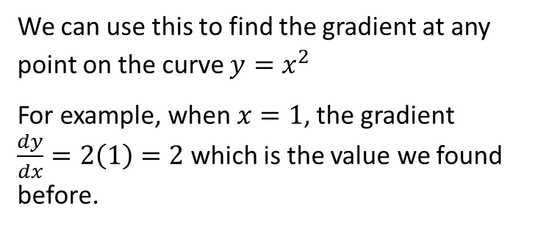

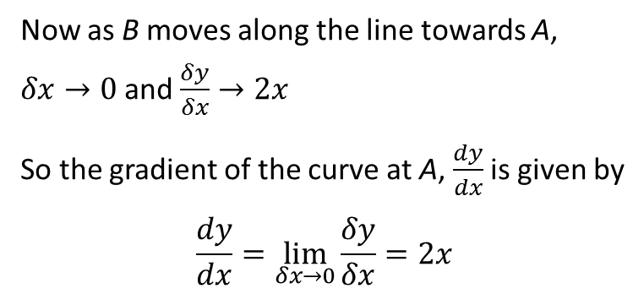
The gradient of $y=x^{2}$ at any point
Now as B moves along the line towards A, $δx→0$ and $\frac{δy}{δx}→2x$
So the gradient of the curve at A, $\frac{dy}{dx}$ is given by
$$\frac{dy}{dx}=\lim_{δx→0}{\frac{δy}{δx}=2x}$$
We say that $2x$ is the derivative of $x^{2}$ with respect to $x$
We can use this to find the gradient at any point on the curve $y=x^{2}$
For example, when $x=1$, the gradient $\frac{dy}{dx}=2\left(1\right)=2$ which is the value we found before.

Slide 23
The gradient of $y=x^{2}$ at any point
Now as B moves along the line towards A, $δx→0$ and $\frac{δy}{δx}→2x$
So the gradient of the curve at A, $\frac{dy}{dx}$ is given by
$$\frac{dy}{dx}=\lim_{δx→0}{\frac{δy}{δx}=2x}$$
We say that $2x$ is the derivative of $x^{2}$ with respect to $x$
We can use this to find the gradient at any point on the curve $y=x^{2}$
For example, when $x=1$, the gradient $\frac{dy}{dx}=2\left(1\right)=2$ which is the value we found before.

Slide 24
The gradient of $y=x^{2}$ at any point
Now as B moves along the line towards A, $δx→0$ and $\frac{δy}{δx}→2x$
So the gradient of the curve at A, $\frac{dy}{dx}$ is given by
$$\frac{dy}{dx}=\lim_{δx→0}{\frac{δy}{δx}=2x}$$
We say that $2x$ is the derivative of $x^{2}$ with respect to $x$
We can use this to find the gradient at any point on the curve $y=x^{2}$
For example, when $x=1$, the gradient $\frac{dy}{dx}=2\left(1\right)=2$ which is the value we found before.

Slide 25
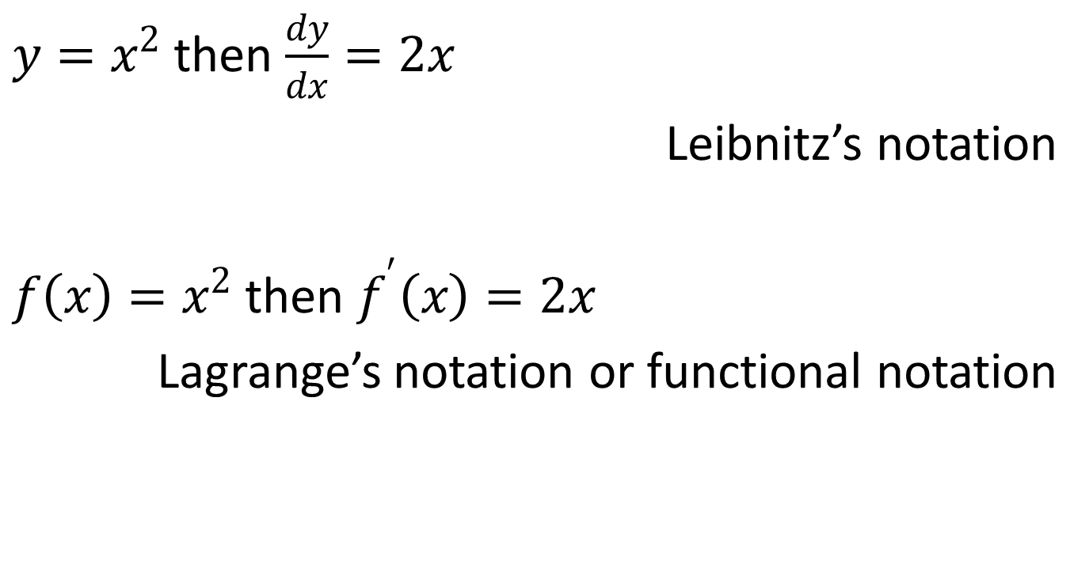
Notation
$y=x^{2}$ then $\frac{dy}{dx}=2x$
Leibnitz’s notation
$f\left(x\right)=x^{2}$ then $f^{′}\left(x\right)=2x$
Lagrange’s notation or functional notation

Slide 26
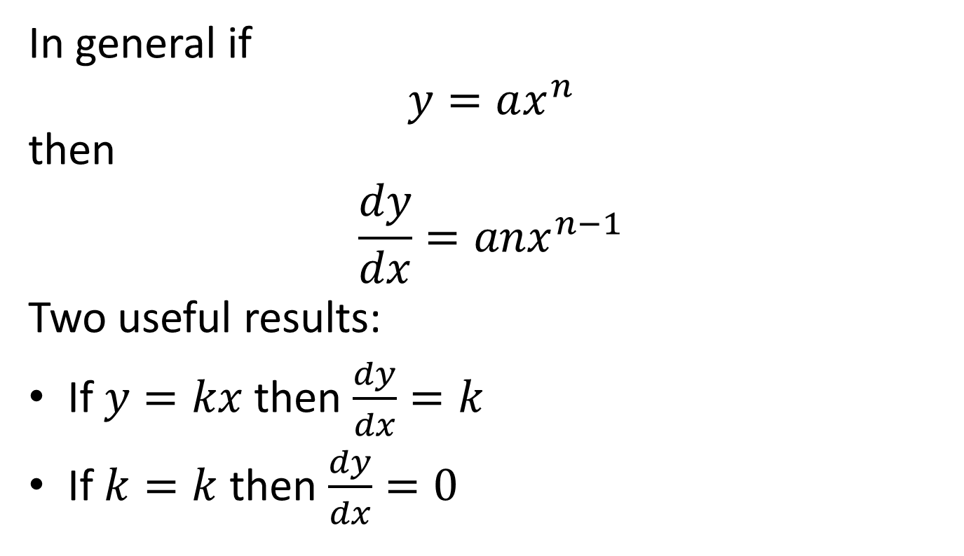
General Result
In general if
$$y=ax^{n}$$
then
$$\frac{dy}{dx}=anx^{n−1}$$
Two useful results:
If $y=kx$ then $\frac{dy}{dx}=k$
If $k=k$ then $\frac{dy}{dx}=0$

Slide 27


Examples
$y=4x^{3}$
$y=\frac{5}{x^{3}}$
$y=7$
$y=3x^{2}+2x−1$

Slide 28

Examples
$y=3\sqrt{x}$
$y=\frac{2}{3\sqrt[3]{x^{4}}}$

Slide 29
Successive Differentiation
If a function is differentiated twice we find the second derivative, and so on.
Leibnitz Notation |  | Lagrange’s or Functional Notation
$$y$$ | Original Function | $$f\left(x\right)$$
$$\frac{dy}{dx}$$ | The 1st Derivative | $$f^{′}\left(x\right)$$
$$\frac{d^{2}y}{dx^{2}}$$ | The 2nd Derivative | $$f^{′}′\left(x\right)$$
$$\frac{d^{3}y}{dx^{3}}$$ | The 3rd Derivative | $$f^{′′′}\left(x\right)$$

Slide 30
Applications
Velocity is the rate of change of displacement with respect to time and acceleration is the rate of change of velocity with respect to time.
So if displacement $s$ is a function of time
then velocity $v=\frac{ds}{dt}⇔s=\int{v}dt$
and acceleration $a=\frac{dv}{dt}=\frac{d^{2}s}{dt^{2}}⇔v=\int{a}dt$

